Slide 1
Vehicle Claim Fraud Detection
Group 5:
Ma, Olivia
Zhang, Duoyi
Xu, Haoying
Wu, Sunny
Rodriguez Miranda, Ximena
Montemayor Santibañez, Oscar
Meiga, Ben-Isaac
Repository:
McGill-MMA-EnterpriseAnalytics
/ vehicle-claim-fraud-detection Public

Slide 2

Our Team
Ma, Olivia: Data Analyst
Zhang, Duoyi: Data Analyst
Xu, Haoying: Data Scientist
Wu, Sunny: Data Scientist
Rodriguez Miranda, Ximena: Data Scientist / Project Manager
Montemayor Santibañez, Oscar: Data Scientist
Meiga, Ben-Isaac: Business Analyst

Slide 3
Our Plan
01
Business Landscape
02
Data
03
Modelling
04
Causal Inference
05
Conclusion

Slide 4
01
Business Landscape

Slide 5

Business Landscape
Car Insurance Industry
The market size of industry is $330.4bn in 2023
The recent increase in interest rates has a negative impact on the industry
High number of insurance fraud
Detect fraudulent claims as profit margins are decreasing because of macro-economic factors
Business Problem
Our Objective:

Slide 6
02
Data

Slide 7
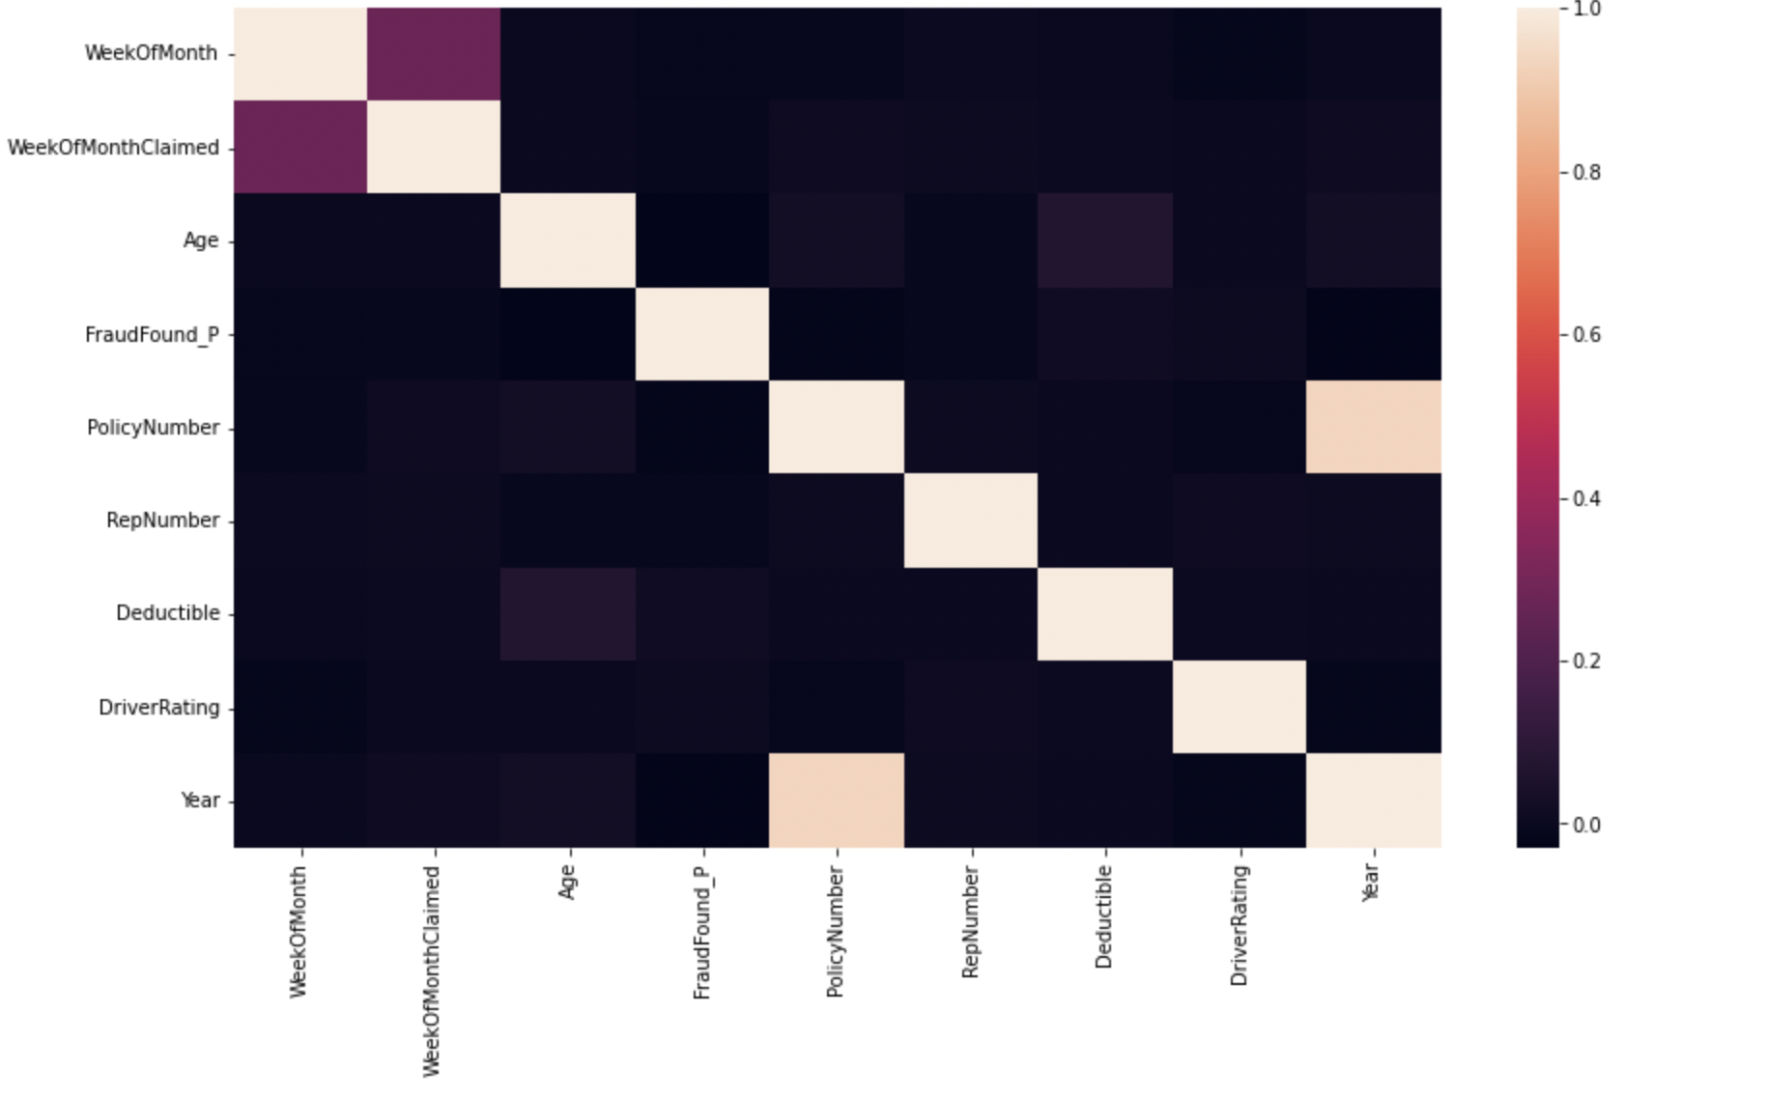
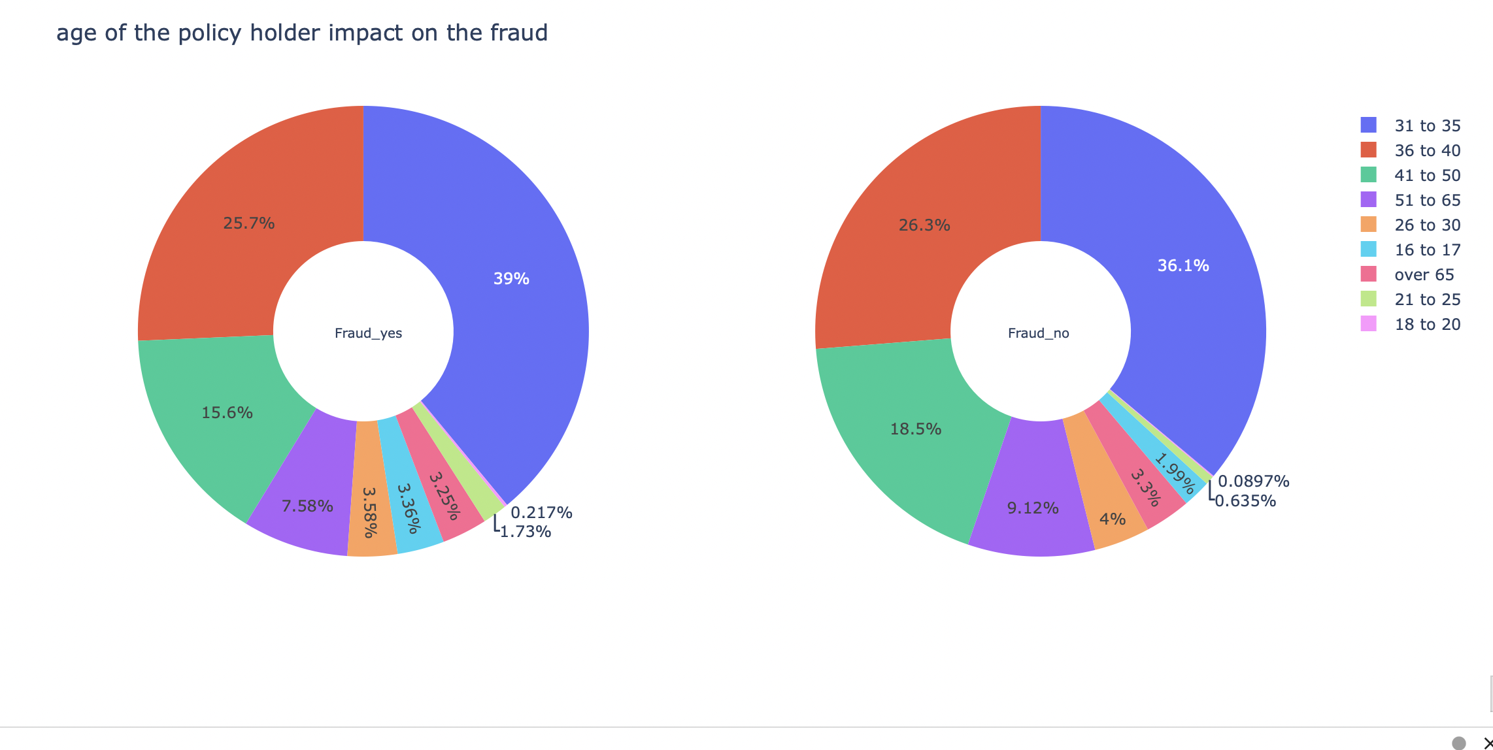
Data Exploration
Data Acquisition
Vehicle Insurance Fraud Detection dataset from Kaggle
This dataset contains 9 numeric variables such as 'AgeOfVehicle', 'AgeOfPolicyHolder', 'DriverRating', etc.
And 22 categorical variables such as 'DayOfWeekClaimed', 'VehicleCategory', etc.
The target is to detect if a claim application is fraudulent or not, 'FraudFound_P'
Notes:
Males produce more claims than females: 13000 vs 2420
Most accidents happen in Urban area: 13822 accidents in urban area vs 1598 accidents in rural areas
Sedans the highest number of accident reported: 9671 accidents vs 5358 for Sport and 391 for Utility
The age group that have the most claims is the 31 to 35 years old with 5593 claims.
The most common age of vehicle involved in accidents is 7 years

Slide 8
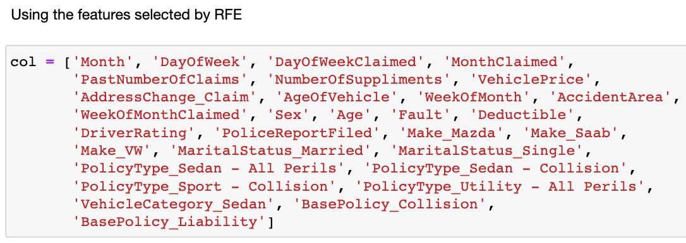
Feature Engineering
Preprocessing steps
RFE was used to perform feature selection
1
Handling zero in dataset
Encoded every categorical variables
Standardized Numeric Variables
Outlier Detection (isolation forest)
2

Slide 9
03
Modeling

Slide 10

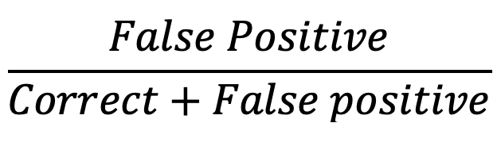

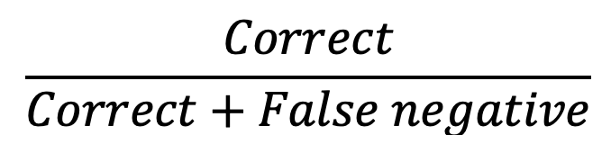
Performance Metrics Selection
Business Problem
Reduce fraudulent claims
FPR =
 | Predict: 0 (Not fraud) | Predict: 1 (Fraud)
True: 0 (Not fraud) | Correct | False positive
True: 1 (Fraud) | False negative | Correct
Max correct fraudulent claim detection
Max Recall
Minimize False Positive Rate (FPR)
Model Solution
Priority:
Max Recall
Add a max threshold of
FPR = 0.4
Recall =

Slide 11



Model Selection
LDA (Linear Discriminant Analysis):
Modeling the distribution of the features for each class (fraudulent or legitimate)
↓
Using Bayes' theorem to calculate the probability of a new claim belonging to each class
 | False Positive Rate [ M I N ] (maximum threshold: 0.4) | Recall [ M A X ]
Dummy Classifier (Benchmark) | 0.00 | 0.00
Logistic Regression | 0.87 | 1.00
KNN | 0.19 | 0.46
Random Forest | 0.59 | 0.93
XGBoost | 0.41 | 0.93
ANN | 0.19 | 0.48
SVM | 0.08 | 0.25
LDA | 0.39 | 0.92
*
Pros
Simplicity and Interpretability
Cons
Assumptions of Normality and Equal Covariance
*
*
Other Applications
Face Recognition
Customer Identification

Slide 12
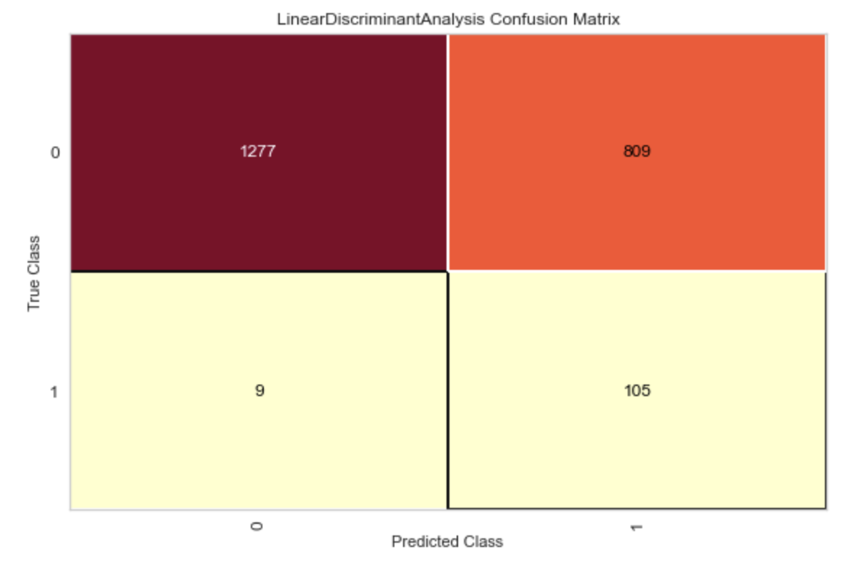
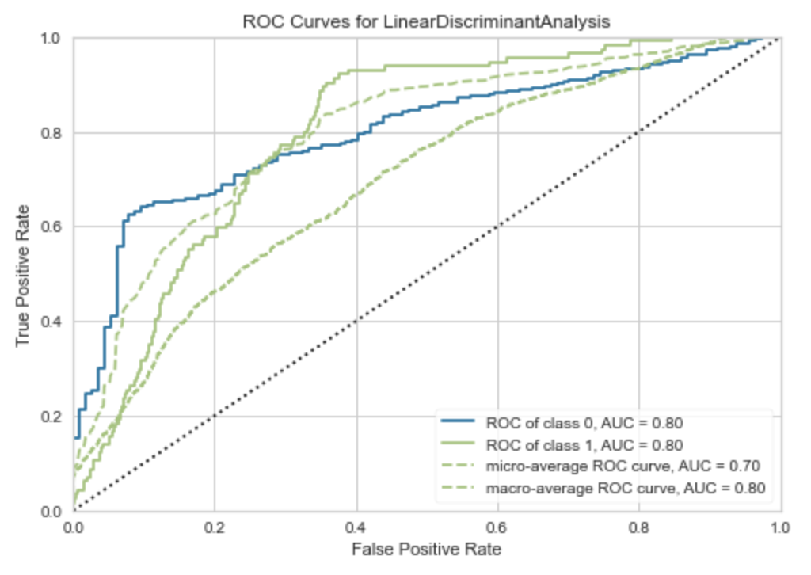
Model Results
Confusion matrix for LDA
Observations
ROC Curves
Rates
1,277
809
Not Fraud
Real
9
105
Fraud
Not Fraud
Fraud
Predicted

Slide 13
04
Casual inference

Slide 14
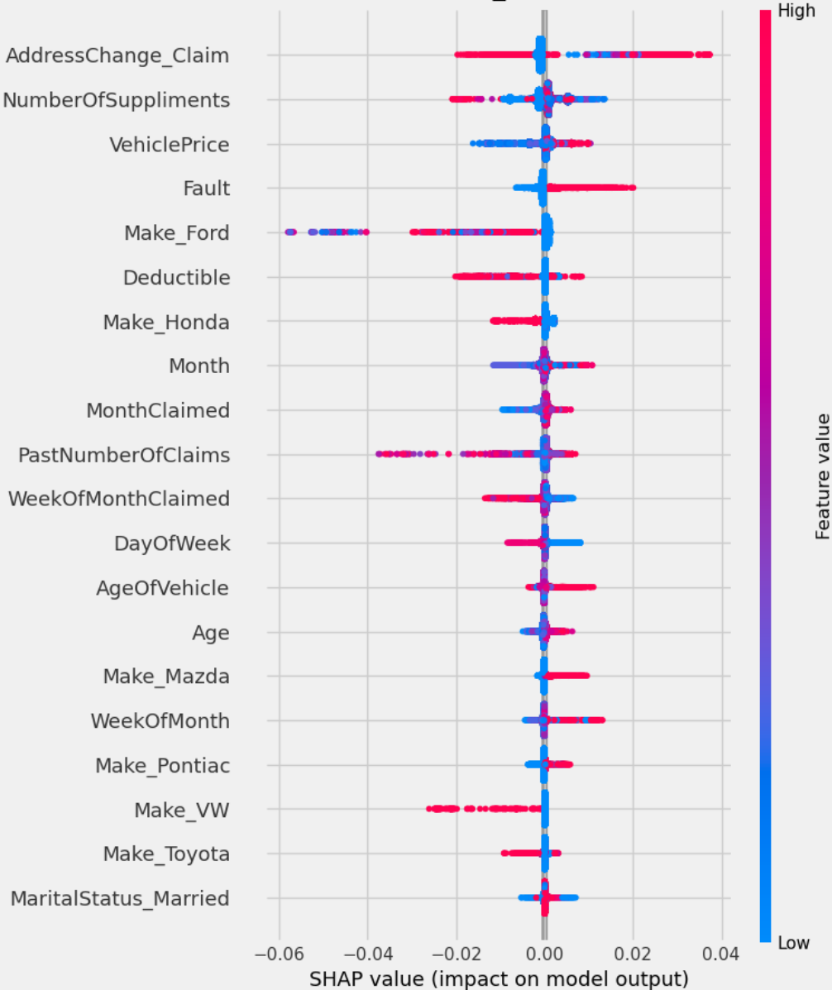
Causal Inference Analysis
Treatment:
Policy Type: All Perils and Collision
Average Treatment Effect
LRS Regressor
-0.47
XGBT Regressor
-0.10

Slide 15
05
Conclusion

Slide 16
Conclusion
Business Impact of our model
Lowering the rate of false positive will improve company's customer satisfaction
Limitation of our model
Limited access to historical data
Better customer retention
It is impossible optimize for false positive and recall at the same time

Slide 17
THANK YOU

